Slide 1
Unit- 1 Data representation
BCA - III year
(Computer System Architecture)
GOVT. NAGARJUNA PG COLLEGE OF SCIENCE RAIPUR
By Neeta dhangar
DEPT of CS

Slide 2
Data representation
Data representation refers to the manner in which data is stored in the computer.
There are several different formats for data storage.
It is important to solve computer problem solver to understand the basic format.
Binary information in digital computers is stored in memory or processor registers. Registers contain either data or control information. Control information Is a bit or a group of bits used to specify the sequence of command signals needed for manipulation of the data in other registers.

Slide 3
Data types
Computer programs or application may use different types of data based on the problem or requirement.
different types of data that computer uses:
Numeric data – Integer and Real numbers
Non-numeric data – Character data, address data, logical data.
Numeric data
It can be of the following two types:
Integers
Real Numbers
Real numbers can be represented as:
Fixed point representation
Floating point representation

Slide 4
Character data
A sequence of character is called character data.
A character may be alphabetic (A-Z or a-z), numeric (0-9), special character (+, #, *, @, etc.) or combination of all of these. A character is represented by group of bits.
A character is represented in standard ASCII format. Another popular format is EBCDIC used in large computer systems.
Example of character data
Rajneesh1#
229/3, xyZ
Mission Milap – X/10

Slide 5
Logical data
A logical data is used by computer systems to take logical decisions.
logical data is denoted by either of two values true (T) or false(F).
A logical data can also be statement consisting of numeric or character data with relational symbols (>, <, =, etc.).
Character set
Character sets can of following types in computers:
Alphabetic characters- It consists of alphabet characters A-Z or a-z.
Numeric characters- It consists of digits from 0 to 9.
Special characters- Special symbols are +, *, /, -, ., <, >, =, @, %, #, etc.

Slide 6
Digital Computer Systems
A computer that stores data in terms of digits (numbers) and proceeds in discrete steps from one state to the next.
In digital computers, even letters, words and whole texts are represented digitally.
Digital systems consider discrete amounts of data.
Examples
26 letters in the alphabet
10 decimal digits
Larger quantities can be built from discrete values:
Words made of letters
Numbers made of decimal digits (e.g. 239875.32)
Computers operate on binary values (0 and 1)
Easy to represent binary values electrically
Voltages and currents.
Can be implemented using circuits
Create the building blocks of modern computers

Slide 7
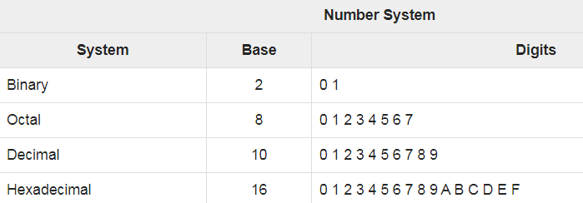
Number system
Binary number system consists of only two values, either 0 or 1
Octal number system represents values in 8 digits(0 to 7).
Decimal number system represents values in 10 digits(0 to 9).
Hexadecimal number system represents values in 16 digits.

Slide 8
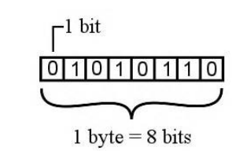
Bits and Bytes
Bits − A bit is a smallest possible unit of data that a computer can recognize or use. Computer usually uses bits in groups.
Bytes − group of eight bits is called a byte. Half a byte is called a nibble.

Slide 9
Size of byte in bits format
Byte Value | Bit Value
1 Byte | 8 Bits
1024 Bytes | 1 Kilobyte
1024 Kilobytes | 1 Megabyte
1024 Megabytes | 1 Gigabyte
1024 Gigabytes | 1 Terabyte
1024 Terabytes | 1 Petabyte
1024 Petabytes | 1 Exabyte
1024 Exabytes | 1 Zettabyte
1024 Zettabytes | 1 Yottabyte
1024 Yottabytes | 1 Brontobyte
1024 Brontobytes | 1 Geopbytes

Slide 10
Decimal Numbers system
Decimal numbers are made of decimal digits: (0,1,2,3,4,5,6,7,8,9)
To convert Decimal Number System to Any Other Base is quite easy you have to follow just two steps:
A) Divide the Number (Decimal Number) by the base of target base system (in which you want to convert the number: Binary (2), octal (8) and Hexadecimal (16)
B) Write the remainder from step 1 as a Least Signification Bit (LSB) to Step last as a Most Significant Bit (MSB).

Slide 11
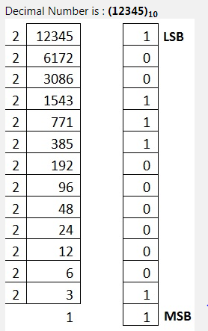
Decimal to binary conversion
Binary Number is (11000000111001)₂

Slide 12
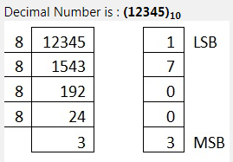
Decimal to octal conversion
Octal Number is (30071)₈

Slide 13
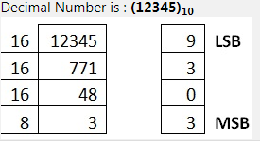
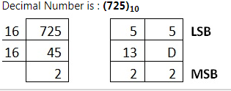
Decimal to hexadecimal
Hexadecimal Number is (3039)₁₆
Hexadecimal Number is (2D5)₁₆ Convert 10, 11, 12, 13, 14, 15 to its equivalent... A, B, C, D, E, F

Slide 14
Other Base System to Decimal Number Base
To convert Any Other Base System to Decimal Number System, you have to follow just three steps:
A) Determine the base value of source Number System (that you want to convert), and also determine the position of digits from LSB (first digit’s position – 0, second digit’s position – 1 and so on).
B) Multiply each digit with its corresponding multiplication of position value and Base of Source Number System’s Base.
C) Add the resulted value in step-B.

Slide 15
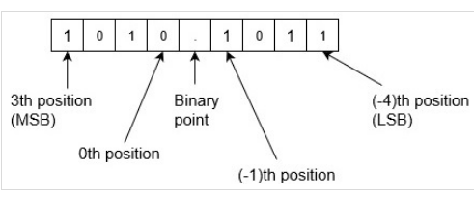
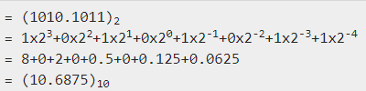
Conversion of Binary to decimal
(11001010)₂ = 1x2+1x2+0x2+0x2+1x2+0x2+1x2+0x2
= 1x2⁷+1x2⁶+0x2⁵+0x2⁴+1x2³+0x2²+1x2¹+0x2⁰ = = 128+64+0+0+8+0+2+0 = (202)₁₀
Example : Convert binary number 1010.1011 into decimal number. Since there is a binary point here with fractional part. So,

Slide 16
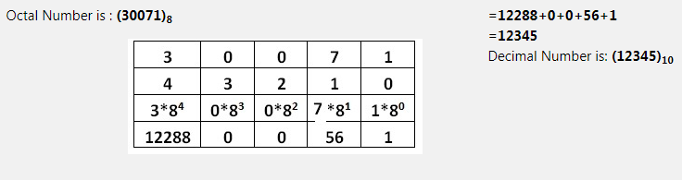
Octal to decimal conversion

Slide 17
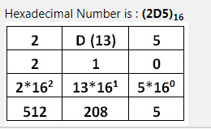
Decimal to hexadecimal conversion
=512+208+5 =725 Decimal Number is: (725)₁₀

Slide 18
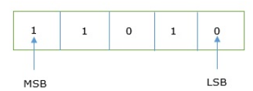
Binary Number System
Each binary digit is also called a bit. Binary number system is also positional value system, where each digit has a value expressed in powers of 2, as displayed here.
2⁵ | 2⁴ | 2³ | 2² | 2¹ | 2⁰
In any binary number, the rightmost digit is called least significant bit (LSB) and leftmost digit is called most significant bit (MSB).

Slide 19
Understanding octal Numbers
Octal numbers are made of octal digits: (0,1,2,3,4,5,6,7)
How many items does an octal number represent?
(4536)₈ = 4x8³ + 5x8² ⁺ 3x8¹ ⁺ 6x8⁰ = (1362)₁₀
What about fractions?
(465.27)₈ = 4x8² ⁺ 6x8¹ ⁺ 5x8⁰ + 2x8⁻¹ ⁺ 7x8⁻²
Octal numbers don’t use digits 8 or 9

Slide 20

Hexadecimal Number System
Hexadecimal num system has 16 symbols – 0 to 9 and A to F where A is equal to 10, B is equal to 11 and so on till F.
Hexadecimal number system is also a positional value system with where each digit has its value expressed in powers of 16, as shown
Decimal equivalent of any hexadecimal number is sum of product of each digit with its positional value.
27FB₁₆ = 2×16³ + 7×16² + 15×16¹ + 10×16⁰
8192 + 1792 + 240 +10
10234₁₀

Slide 21
Fixed point numbers and floating point numbers
To store real no in modern computer we have follow two approaches:
The fixed point numbers in binary used a signed bit a positive number has signed bit 0 and a negative number has a signed number 1.
In fixed point repre its has some issue that’s why we working only floating point number.
Real numbers
Fixed point
Floating point

Slide 22
Complements
Complements are used in digital computers in order to simply the subtraction operation and for the logical manipulations.
For the Binary number (base-2) system, there are two types of complements: 1’s complement and 2’s complement.
1’s Complement of a Binary Number
1’s complement of a binary number is another binary number obtained by toggling all bits in it, i.e., transforming the 0 bit to 1 and the 1 bit to 0.
Examples: 1's complement of "0111" is "1000"
1‘ s complement of "1100" is "0011"

Slide 23
2’s complement of a binary number is 1 added to the 1’s complement of the binary number. Examples:
2's complement of "0111" is "1001“
2's complement of "1100" is "0100"

Slide 24
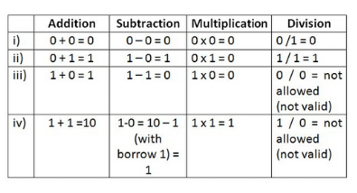
Arithmetic operation on binary numbers

Slide 25
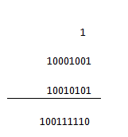
Binary addition
here are four steps in binary addition, they are written below
0 + 0 = 0
0 + 1 = 1
1 + 0 = 1
1 + 1 = 0 (carry 1 to the next significant bit)
An example will help us to understand the addition process. Let us take two binary numbers 10001001 and 10010101.

Slide 26
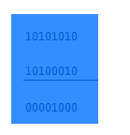
Binary Subtraction
0 – 0 = 0
0 – 1 = 1, borrow 1 from the next more significant bit
1 – 0 = 1
1 – 1 = 0

Slide 27
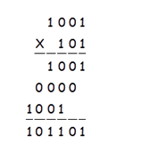
Binary Multiplication
0×0=0
1×0=0
0×1=0
1×1=1 (there is no carry or borrow for this)

