Slide 1
Structure and function in C++
BCA - II Year
PROGRAMMING IN CPP
Govt. Nagarjuna PGc college of Science Raipur
Prepared by :
Neeta Dhanagr
Guest faculty
Dept. of CS

Slide 2
Structure and function in C++
Structure variables can be passed to a function and returned in a similar way as normal arguments.
Passing structure to function in C++
A structure variable can be passed to a function in similar way as normal argument. Consider this example:

Slide 3
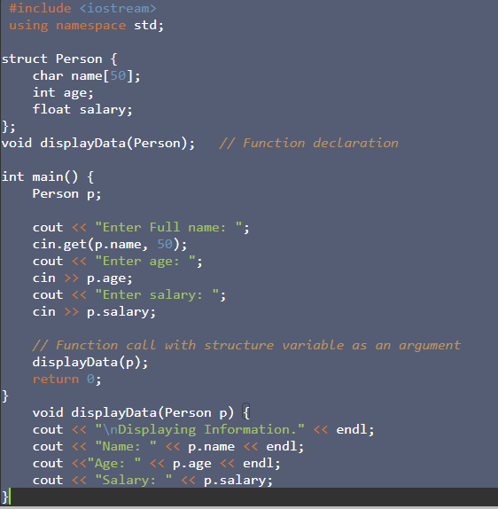
In this program, user is asked to enter the name, age and salary of a Person inside main() function.
Then, the structure variable p is to passed to a function using.
displayData(p);
The return type of displayData() is void and a single argument of type structure Person is passed.

Slide 4
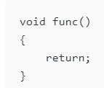
Returning values from function
Using return statement in void return type function:
we know that, if there is a void return type in the function definition, then there will be no return statement inside that function.
But if there is a return statement inside it, then also there will be no problem if the syntax of it will be:
This syntax is used in function just as a jump statement in order to break the flow of the function and jump out of it.

Slide 5
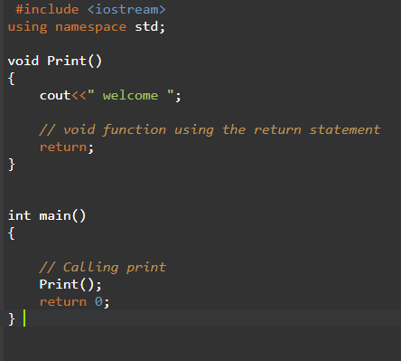

Slide 6
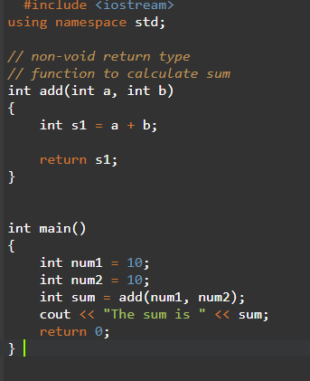
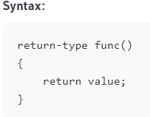
Functions returning a value
For function that define a return type, the return statement must be immediately followed by the return value of that specified return type.

Slide 7
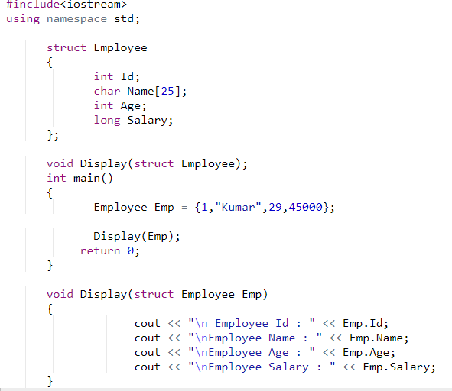
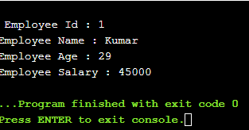
Passing Structure by Value
In this approach, the structure object is passed as function argument to the definition of function, here object is reperesenting the members of structure with their values.

Slide 8
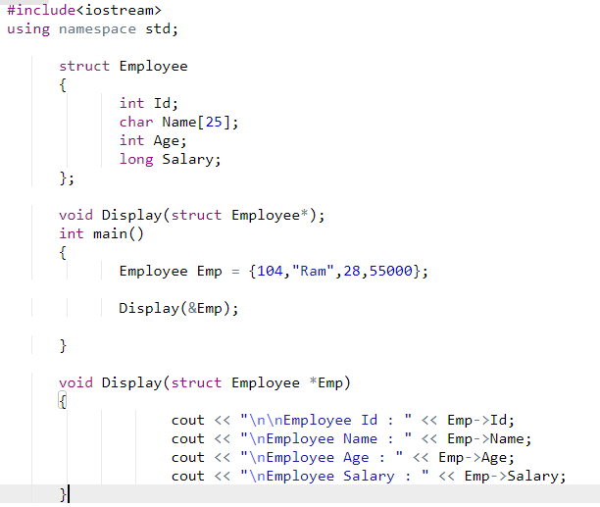
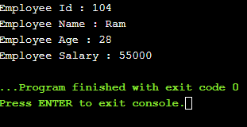
passing structure object by reference
In this approach, the reference/address structure object is passed as function argument to the definition of function.

Slide 9
Function overloading
Function Overloading is defined as the process of having two or more function with the same name, but different in parameters is known as function overloading .
In function overloading, the function is redefined by using either different types of arguments or a different number of arguments.
It is only through these differences compiler can differentiate between the functions.
Eg -
int sum(int a,int b);
float sum(float a, float b);
int sum(double a,double b );

Slide 10
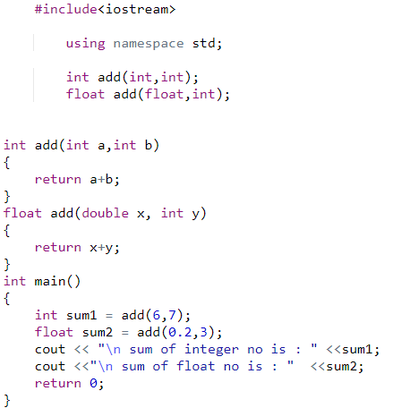
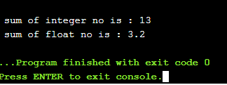

Slide 11
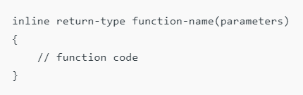
Inline function
a function call transfers the control from the calling program to the called function. This process of jumping to the function, saving registers, passing a value to the argument, and returning the value to the calling function takes extra time and memory.
An inline function is a function that is expanded inline when it is invoked, thus saving time. The compiler replaces the function call with the corresponding function code, which reduces the overhead of function calls.

Slide 12
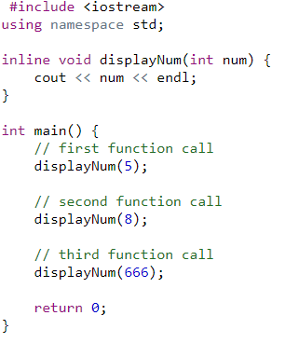


Slide 13
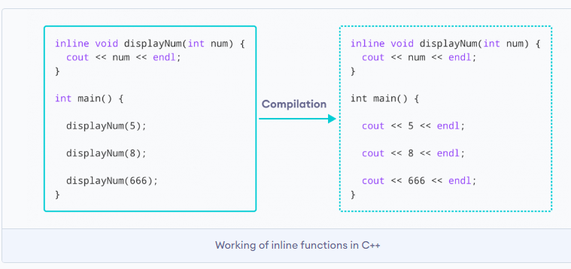
How inline function work
Here, we created an inline function named displayNum() that takes a single integer as a parameter.
We then called the function 3 times in the main() function with different arguments. Each time displayNum() is called, the compiler copies the code of the function to that call location.

Slide 14
